Slide 1
Chapter 4
Pacing
The field engineer can use pacing to quickly check measurements made by more precise means (i.e. with a steel tape).
Some people count a step (left foot then right foot) as a pace. Others count when either the left or right foot strikes the ground as a pace. Either method is O.K. just be consistent.

Slide 2
Chapter 4
Pacing
Determine pace length by stepping off the known distance between two points several times and take an average. 100 feet is a good distance.
(33 + 33 + 34 + 32 + 35) / 5 = 33.4 steps or paces. Paces for 100 ft. is between 33 and 34. Knowing the number of paces for 100 feet helps in determining lengths of 10 ft. 25 ft. 50ft. etc.
Distance divided by the number of paces equals the length of pace.
100 ft./33.4 steps = 2.99 ft./step (pace length)

Slide 3
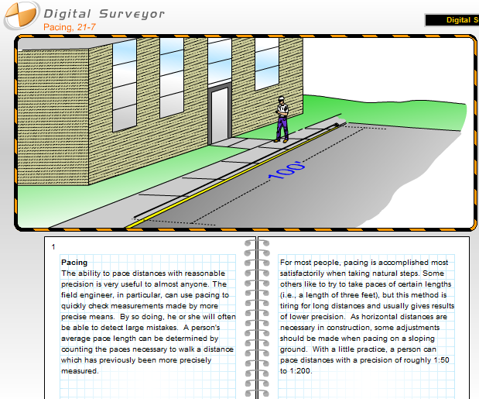

Slide 4
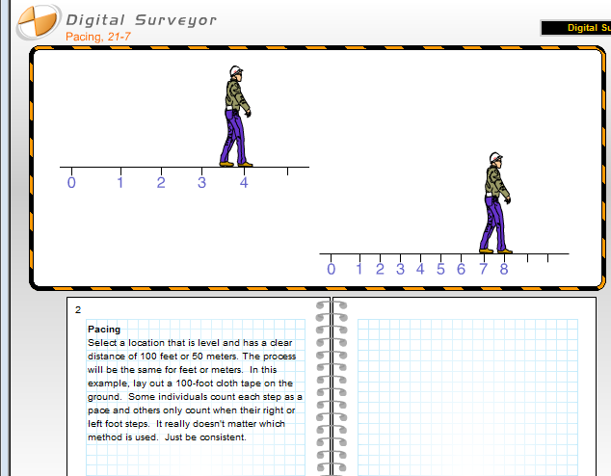

Slide 5
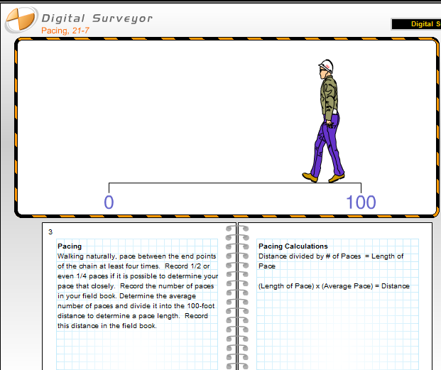

Slide 6
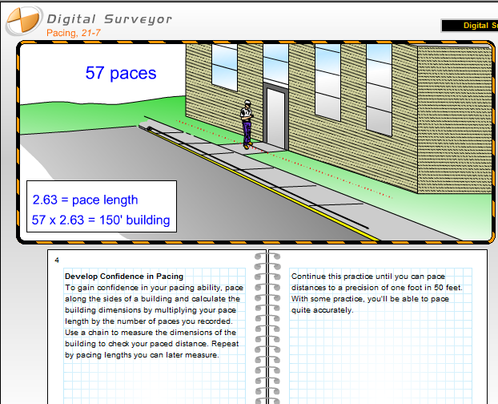

Slide 7
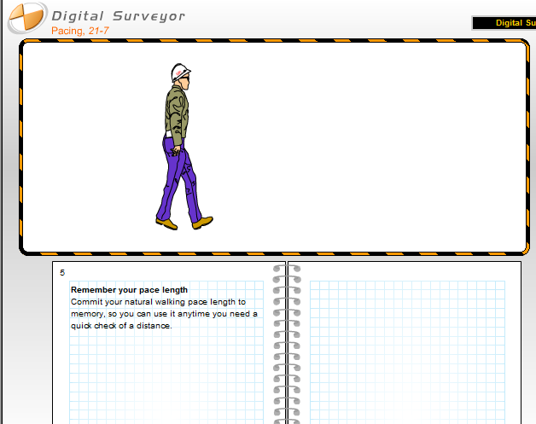

Slide 8
Chapter 4
Chaining
Chaining requires two people working together.
Engineer’s chain is graduated in feet, tenths and hundredths not in inches or fractions of an inch.
It is a good idea not to “cut” or “burn” any length on a steel or cloth tape. Cutting or burning a length is generally done because the zero mark on the tape can’t be found. Cutting or burning could introduce errors in measurements (aka human errors).

Slide 9
Measurement of Distance
6 Steps of Taping
Lining in – shortest distance between two points is a straight line.
Applying tension – rear chain is anchor and head chain applies required tension.
Plumbing – horizontal distance requires tape to be horizontal.
Marking tape lengths – each application of the tape requires marking using chaining pins to obtain total length.
Reading the tape – the graduated tape must be read correctly.
Recording the distance – the total length must be reported and recorded correctly.

Slide 10
Types of Chains and Tapes
Before the ability to make steel rods and bands, sticks were cut into lengths of 16.5’ (Rod) and they were laid end to end to measure.
Gunter’s Chain
  66’ long with 100 link w/each link being 7.92 inches or 66 feet long
  Developed by Edmund Gunter in 1600’s in England and made with individual wires with a loop at each end connected
  Chain had between 600-800 wearing surfaces which with hard use would wear and cause chain to elongate
  Measurements were recorded in chains and links
  1 chain = 4 rods; 80 chains = 1 mile

Slide 11
Types of Chains and Tapes
Engineer’s Chain
  Same construction as Gunter’s Chain, but each link is 1.0’ long and was used for engineering projects
Surveyor’s and Engineer’s Tapes
  Made of ¼” to 3/8” wide steel tapes in 100’; 200’; 300’ lengths
  Multiple types of marking and graduation:
    Available in chains, feet, and metric
    Graduated:
      Throughout – feet and tenths marked the entire length
      Extra foot – feet marked the length of the tape with additional foot at the 0 end graduated in tenths and hundreds of the foot

Slide 12
Types of Chains and Tapes
Invar Tapes
  Made of special nickel steel to reduce length variations due to temperature changes
  The tapes are extremely brittle and expensive
  Used most of the time for standard comparison of tapes
Cloth, Fiberglass, and PVC Tapes:
  Lower accuracy and stored on reels. Used for measurement of 0.1’ accuracy requirements
  Accessories
Chaining Pins – set of 11, used to mark the tape lengths
Hand Level – used to determine required plumbing height
Plumb Bob – used to transfer the mark from the tape to ground
Tension Handle – used to maintain correct tension on tape

Slide 13
Modern Chains
Modern surveying chains are three standard types.
  Fully graduated
First foot (cut chain)
Extended foot (add chain)

Slide 14
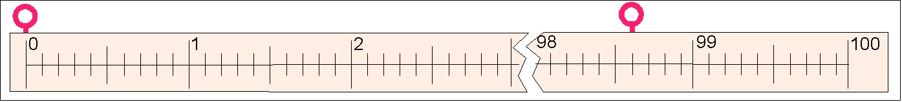
Reading Surveying Steel Chain
The first step in reading a surveying chain is to determine the units that are used.
Note: this a fully graduated chain
Knowing that the chain is 100 feet long, having numbers from 0 to 100 indicates that each number is one foot of distance.
Each foot has nine (9) lines (10 spaces), therefore each line represents 1/10 or 0.10 of a foot.
The reading for this example is 98.6 ft.

Slide 15
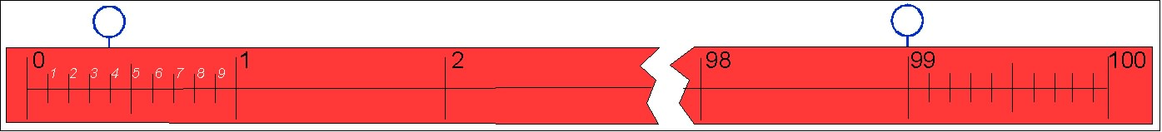
Reading A Cut Chain
The first foot or cut chain gets its name from the fact that the whole foot reading at the head of the chain must be reduced “cut” by the partial foot.
In this example the pin at the head is on 99 feet and the rear pin is on 0.4 feet. The distance is 99 - 0.4 or 98.6 feet.

Slide 16
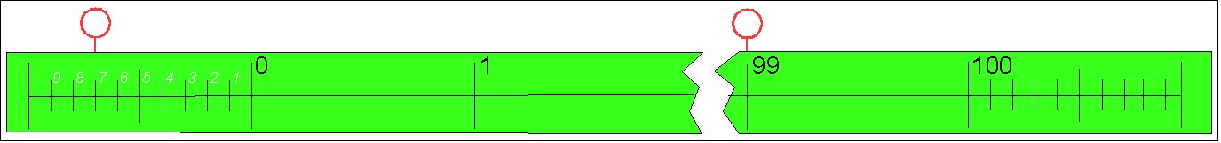
Reading An Add Chain
The extended foot (add) chain gets its name because an additional foot is added to each end of the chain.
The partial foot is added to the foot value at the head of the chain.
In this example the head pin is on 99 feet an the rear pin is at 0.7 feet. The distance is 99 + 0.7 or 99.7 ft.

Slide 17
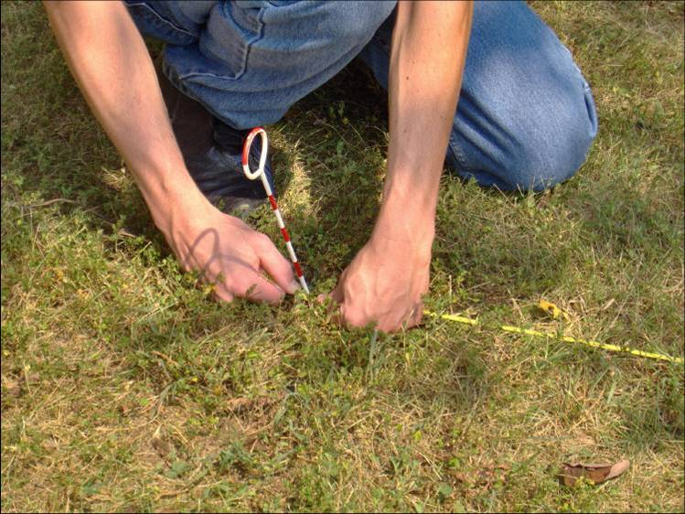
Taping (Field Process)
The line to be taped should be marked at both ends
  Keeps measurement on line
  Rear chain person should keep the head chain person on line
  1’ of line error/100’ = 0.01’ error in length
Applying Tension
  Rear chainman is anchor and should hold 100’ mark over point
    Tension is applied by head chain person – normally 12 to 30 pounds of pull
    Tapes are standardized at 12 lbs., but greater is utilized to compensate for sag

Slide 18
Taping (Field Process)
Plumbing
  One end of tape is raised to maintain a horizontal measuring plane. ONLY one end is elevated
    This allows measurements to be made on uneven ground
    If a high spot exists in center, “break” tape by measuring to the top and then move forward to complete the distance

Slide 19
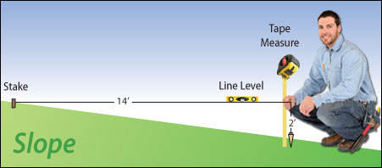
Taping (Field Process)

Slide 20
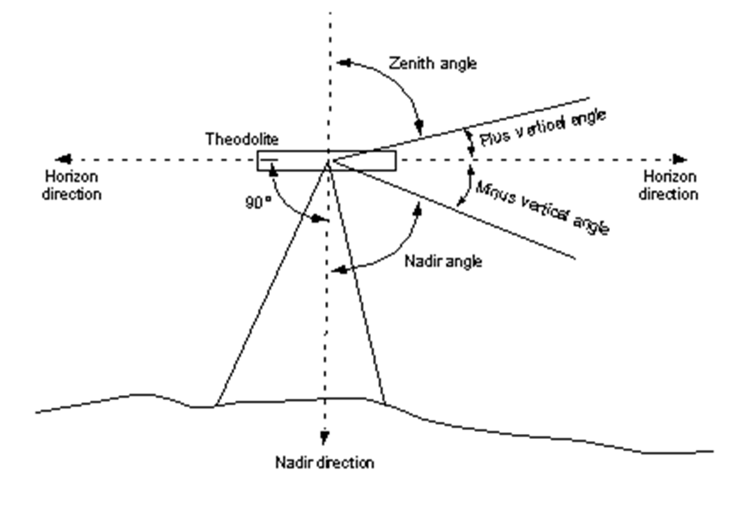
Slope Measurements:
Generally, measurements are made horizontally, but on even, often man-made slopes the distance can be measured directly on the slope, but the vertical or zenith angle must be obtained.
Horizontal Distance = (sin Zenith Angle) X (Slope Distance)
Horizontal Distance = (cos Vertical Angle) X (Slope Distance)

Slide 21
Stationing:
Starting point is 0+00 and each 100’ is one station ∴50’ from starting point is Station 0+50, 100’ = 1+00, 150’ = 1+50, 200’ = 2+00
If distance is 857.23’ from starting point, it is expressed as Station 8+57.23, 1023.79 = 10+23.79, 10465.88 = 104+65.88

Slide 22
Chapter 4
Chaining
Discrepancy Ratio – is found by taking the difference between the forward and backward measurements then dividing the difference by the mean or average of the forward and backward measurements. Once this is determined, the result is divided into the number 1 (reciprocal). This yields the Discrepancy Ratio.

Slide 23
Chapter 4
Chaining
Example:
(185.16 + 185.18) / 2 = 185.17 (mean)
(185.16 – 185.18) / 185.17 = 0.000108009
1 / 0.000108009 = 9258.5
Discrepancy Ratio = 1 / 9300

